Slide 1

Introduction to Artificial Intelligence Group 1 Week 5
Dr. Juan Carlos Rojas
Juan-Carlos.Rojas@ttu.edu

Slide 2
Schedule
Date | Class | HW Assigned | HW Due
May 18 | Class 1 | HW1
May 25 | Class 2 | HW2 | HW1
June 1 | Class 3 | HW3 | HW2
June 8 | Class 4 | HW4 | HW3
June 15 | No class
June 22 | Class 5 | HW5 | HW4
June 29 | Class 6 | HW6 | HW5
July 6 | Class 7 | HW7 | HW6
July 13 | Class 8 |  | HW7

Slide 3
Agenda for Week 5
Theory
TensorFlow
TensorFlow basics
Matrix operations
Gradient computations
Mini-batch gradient descent
Neural Networks
History
Topologies
Shallow networks
Preventing overfitting
Practice
Tensorflow
Basic computations
Solving Normal equations
Gradient descent
Logistic regression
Softmax regression
Mini-batch training
Shallow neural networks
Early stopping
Regularization

Slide 4
Aviso Importante
Para todos los becados por el MICITT, es obligatorio llenar un formulario inicial de participantes que pueden localizar en el siguiente enlace:
http://www.conicit.go.cr/tramites/Seguimiento_PINN.aspx.
Buscar “Formulario de información inicial para los participantes”, y seguir el vínculo al formulario electrónico.
Este formulario es parte obligatoria de su beca, por lo que el 100% de los becados deben llenarlo.

Slide 5
TensorFlow

Slide 6

TensorFlow
A generic computation framework developed by Google
You first create a description of the computation
Then you execute it
The framework of choice for neural networks
Maps well to GPUs
Requires special installation
Can map to clusters of computers

Slide 7
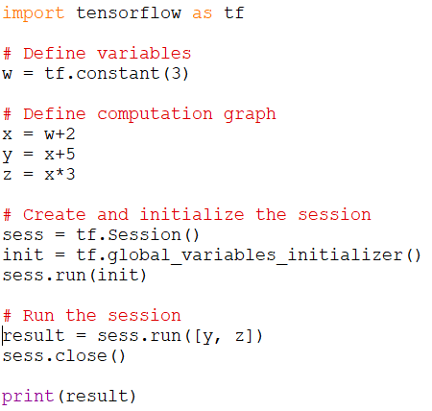
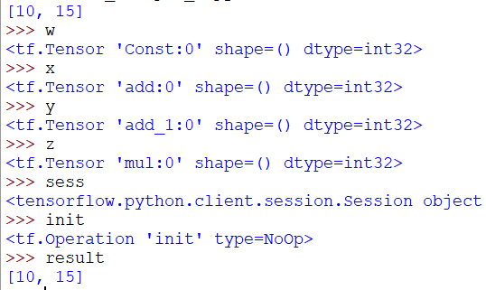
TensorFlow Example 1
See TensorFlow_Example_1.py

Slide 8
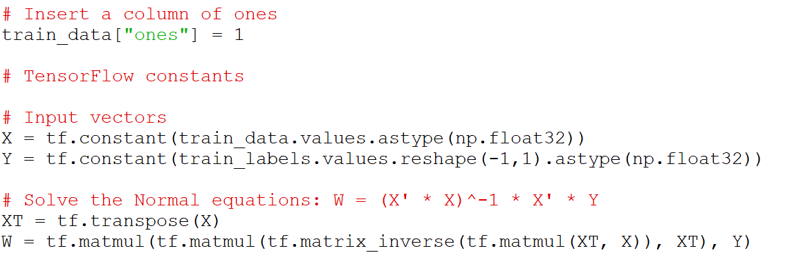
Solving Normal Equations in TensorFlow
We can operate in vectors and matrices in TensorFlow
For example, we can solve the Normal equations
See VehiclePrice_LinearRegression_tf_1.py

Slide 9
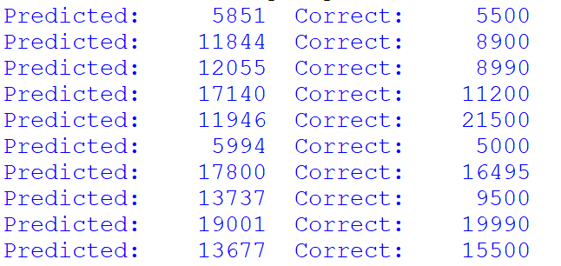
Practice 1
Use Tensorflow to solve the Normal equations of a linear regression model of vehicle prices
See VehiclePrice_LinearRegression_tf_1.py
Add TensorFlow instructions to compute the prediction values against the test dataset
Hints:
You need to declare a vector for the test data
Multiply it by W
Print the first 10 prediction values
Compare with the first 10 correct label values

Slide 10
Solving Gradient Descent in TensorFlow
We can solve linear regression coefficients by gradient descent
Algorithm:
Define the input vectors for X and Y
Initialize the vector of coefficients to random values
Compute the prediction Y_pred = X * W
Compute the MSE
Compute the gradient of the MSE w.r.t. each feature
Update the coefficients as W - learning_rate * gradients
Repeat 3-6 until converged, or after a given number of iterations
This is considered a batch approach
We are using all available data at every iteration

Slide 11
Computing Gradients
There are several possible methods:
Numerical differentiation
Fast but inaccurate
Symbolic differentiation
Slow and complicated
Forward-mode automatic differentiation
Computation is broken down into basic arithmetic operations whose derivative is known
Chain-rule is used to compute the numerical result
Accurate
Reverse-mode automatic differentiation
The same, but working from the output backward to the input
Saves computations when there are few outputs
TensorFlow uses reverse-mode auto-diff
Accurate & fast
Recommended reading:
https://www.cs.toronto.edu/~rgrosse/courses/csc321_2018/slides/lec10.pdf

Slide 12
Solving Gradient Descent in TensorFlow
Define the input vectors for X and Y
Initialize the vector of coefficients to random values
Compute the prediction Y_pred = X * W
Compute the MSE
See VehiclePrice_LinearRegression_tf_2.py

Slide 13
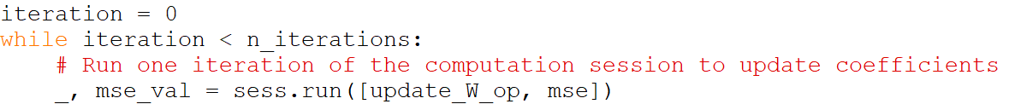
Solving Gradient Descent in TensorFlow
Compute the gradient of the MSE w.r.t. each feature
Update the coefficients as W - learning_rate * gradients
Repeat 3-6 until converged, or after a given number of iterations
See VehiclePrice_LinearRegression_tf_2.py

Slide 14
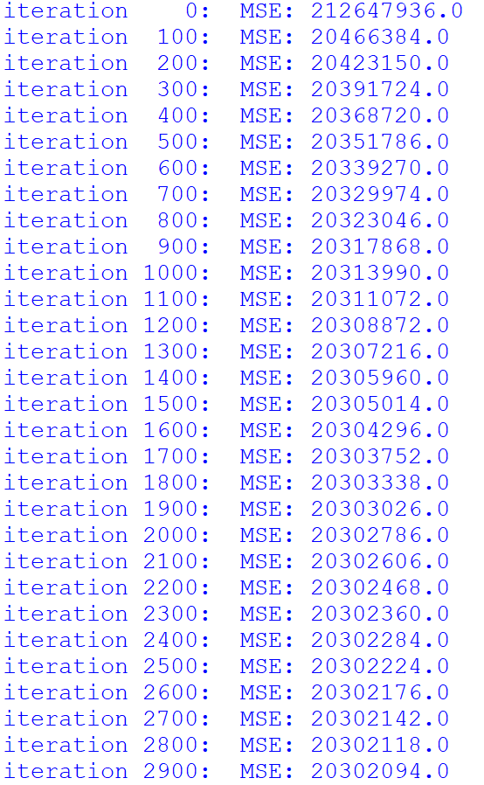
Solving Gradient Descent in TensorFlow
The algorithm gradually reduces the MSE
It takes a few 1000s of iterations to converge
Depends on the learning rate
See VehiclePrice_LinearRegression_tf_2.py

Slide 15
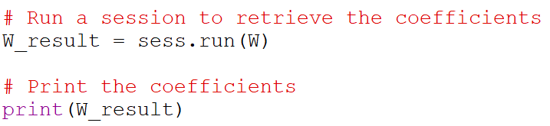
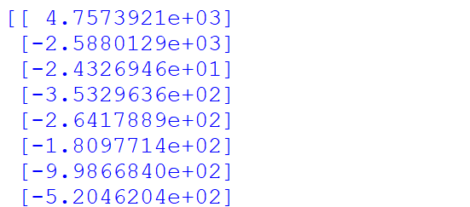

Solving Gradient Descent in TensorFlow
The coefficients can be retrieved by running a session for them:
The training RMSE is obtained from the MSE measurement we already have
See VehiclePrice_LinearRegression_tf_2.py

Slide 16
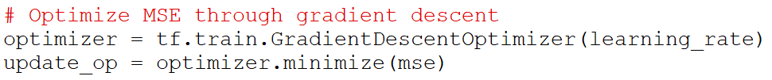
Using Tensorflow Optimizers
We can use a built-in gradient descent optimizer
Replaces steps 5 & 6 of the previous list
The results are the same
Runs a little bit faster
There are other kinds of optimizers (momentum, adagrad, etc.)
May converge faster
See VehiclePrice_LinearRegression_tf_3.py

Slide 17
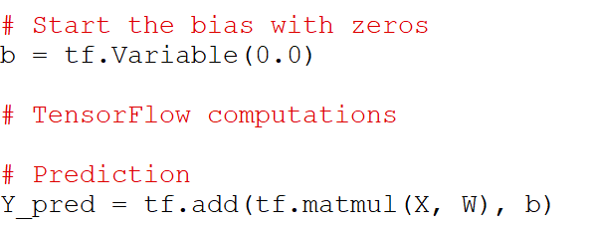
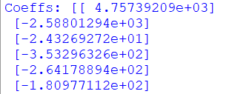
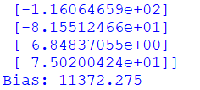
Using a Bias Variable
Instead of adding a column of ones, we can use a separate variable for the intercept weight
We will call it bias
The gradient optimizer will now update both W and b
The results are exactly the same as before
W has one less coefficient, which is now in b
See VehiclePrice_LinearRegression_tf_4.py

Slide 18

Practice 2
Use Tensorflow to to solve a linear regression model for vehicle prices using gradient descent
You can base it on VehiclePrice_LinearRegression_tf_4.py
Add Tensorflow instructions to compute the RMSE of the test predictions against the test labels
Hints:
Compute the predictions against the test data as Y_pred_test = X_test * W + b
Compute the test MSE as test_mse = tf.reduce_mean(tf.square(Y_pred_test - Y_true_test))
At the end, run a TensorFlow session to compute the value of test_mse

Slide 19
Optional HW Problem 2b
Adjust the learning rate in the gradient descent solution of the vehicle price linear regression
What happens if the learning rate is very large?
What happens if it is very small?

Slide 20
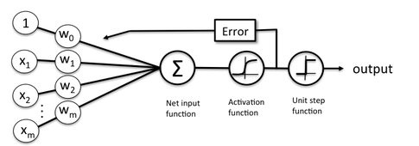
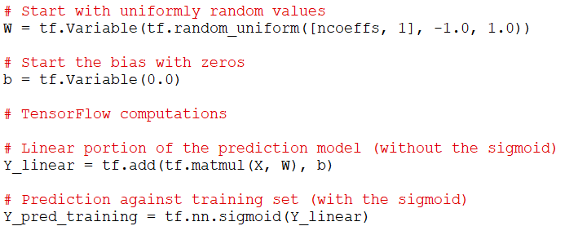
Implementing Logistic Regression in TensorFlow
We use the same gradient descent approach
One vector of coefficients plus a bias
We add a sigmoid function to the prediction
See CreditDefault_LogisticRegression_tf_1.py

Slide 21
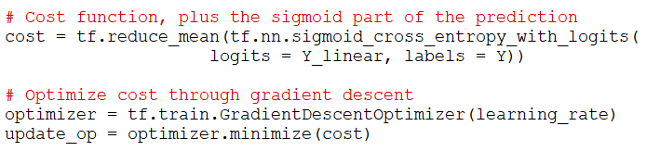
Implementing Logistic Regression in TensorFlow
For the cost function, we use a built-in TensorFlow cross-entropy function
It includes the sigmoid function, so we pass-in only the linear portion
This produces a cost value for each test case
We compute an average of all of them
Optimize by gradient descent as before
See CreditDefault_LogisticRegression_tf_1.py

Slide 22
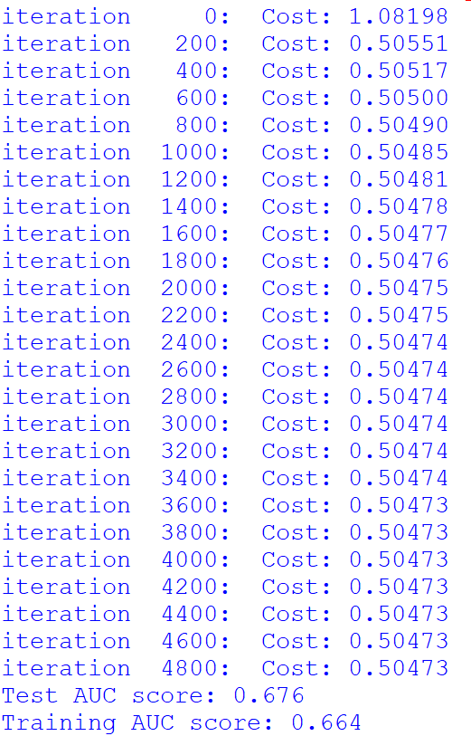
Implementing Logistic Regression in TensorFlow
It converges after a few 1000s of iterations
Depends on the learning rate
See CreditDefault_LogisticRegression_tf_1.py

Slide 23
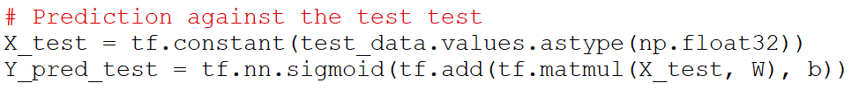
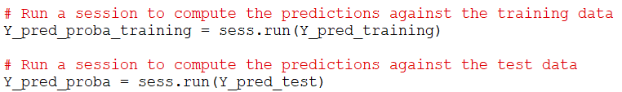
Implementing Logistic Regression in TensorFlow
To compute the predictions against the test set we need to add a few more computations
And then run a Tensorflow session to compute them
See CreditDefault_LogisticRegression_tf_1.py

Slide 24
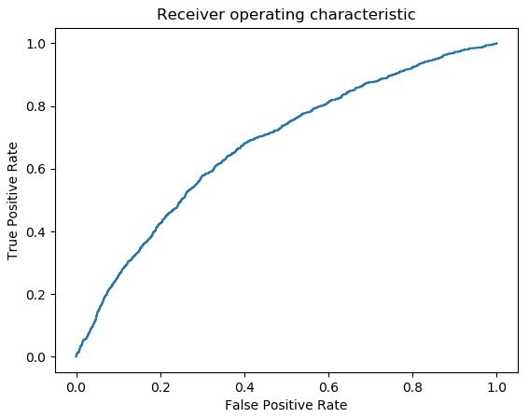
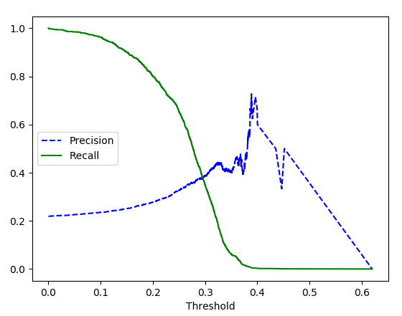

Implementing Logistic Regression in TensorFlow
The prediction probabilities can then be plugged-in to sklearn.metrics to evaluate the classifier
See CreditDefault_LogisticRegression_tf_1.py

Slide 25
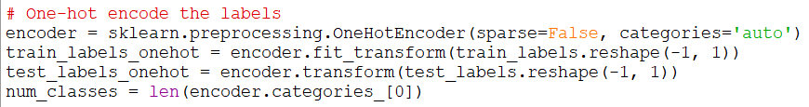

Softmax Regression in TensorFlow
Extending to multinomial classification follows the same structure
The labels need to be one-hot encoded
We can use sklearn.preprocess for this:
Use the one-hot-encoded labels as the matrix Y for training
See Mnist_SoftmaxRegression_tf_1.py

Slide 26
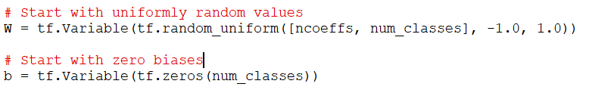
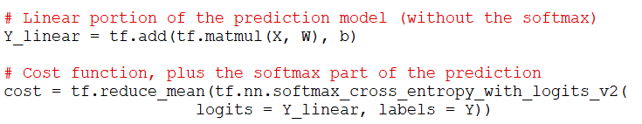
Softmax Regression in TensorFlow
Define the coefficient matrix (one row per class)
The biases are a vector (one per class)
We use the softmax version of the cost function:
See Mnist_SoftmaxRegression_tf_1.py

Slide 27
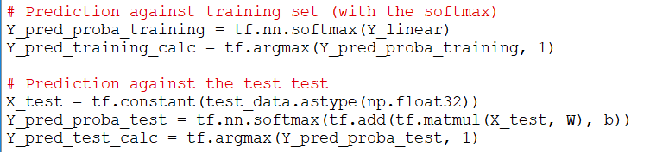
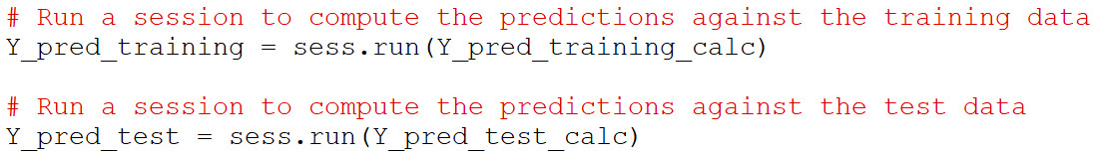
Softmax Regression in TensorFlow
We compute the probability similar to before
Use softmax instead of sigmoid
Determine the winning class by maximum
We run a session to compute them at the end
See Mnist_SoftmaxRegression_tf_1.py

Slide 28
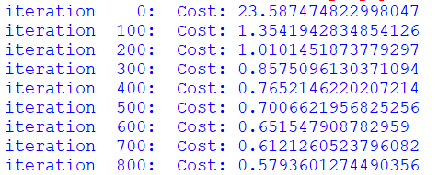
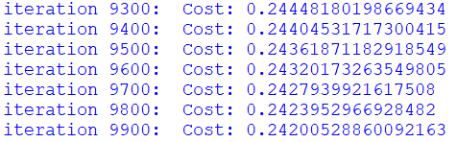
Softmax Regression in TensorFlow
The gradient descent is taking very long to run
It was not fully converged after 10,000 iterations!
We can try to increase the learning rate, but if we do it too much, it will have trouble converging
See Mnist_SoftmaxRegression_tf_1.py

Slide 29
Strategies to Speed-Up Convergence
Better initialization of coefficients
Xavier’s (Glorot) initialization
Learning-rate schedule
Linear decay
Exponential decay
Adaptive learning rate schemes
Momentum
Adagrad
RMSprop
Adam

Slide 30

Xavier’s Initialization
You can get faster convergence is you use initial coefficient values that distributed normally
Use a standard deviation such that
This is known as Xavier’s initialization, or Glorot initialization
See Mnist_SoftmaxRegression_tf_2.py

Slide 31
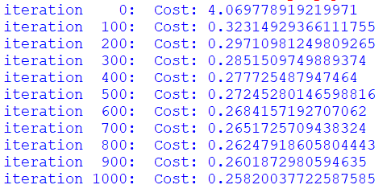
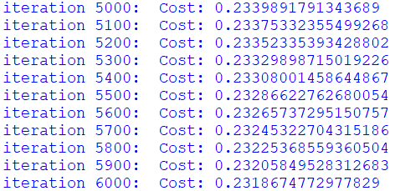
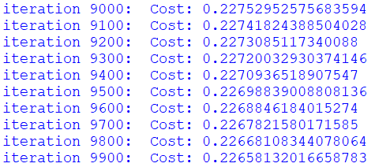
Xavier’s Initialization
This time it converges much faster
But it still takes close to 10,000 iterations to reach a stable value
We need something faster
Stochastic gradient descent
See Mnist_SoftmaxRegression_tf_2.py

Slide 32
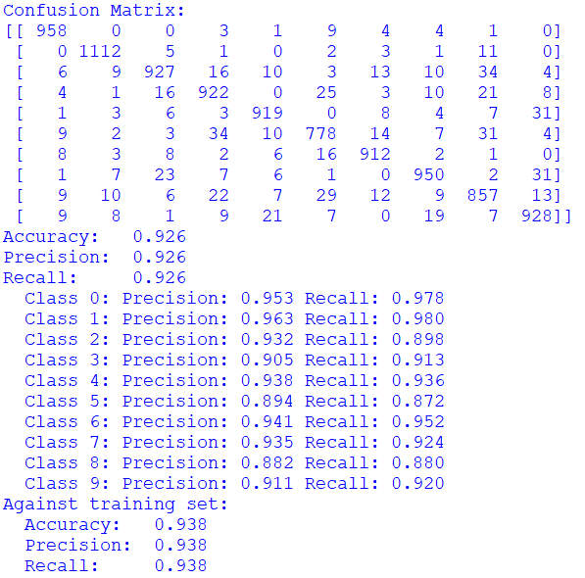
Softmax Regression in TensorFlow
The results are consistent with previous results from sklearn
See Mnist_SoftmaxRegression_tf_2.py

Slide 33
Optional HW Problem 2c
Replicate the gradient descent solution for softmax regression of MNIST images
Use Mnist_SoftmaxRegression_tf_2.py as a base
Adjust the learning rate to make it converge faster
Can you get to the same test accuracy result?

Slide 34
Stochastic Gradient Descent

Slide 35
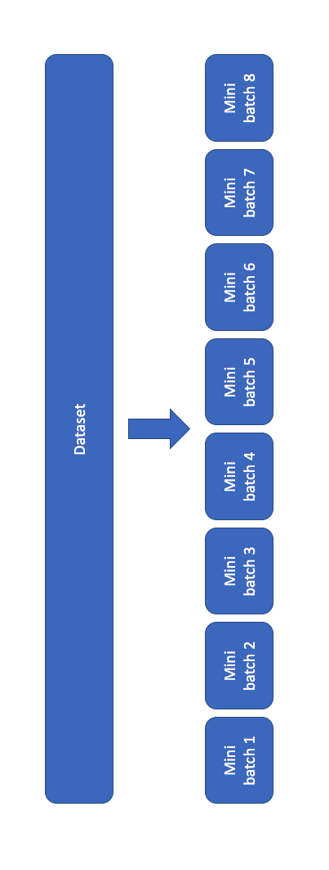
Stochastic Gradient Descent
Uses a random subset of the training data in every iteration
Picking a true random subset at every iteration is expensive
In practice, most people use mini-batch gradient descent instead
Mini-batch gradient descent:
Divide the training data into blocks and cycle through all of them
One block per update iteration
One pass through all of the blocks is called an epoch
Start by using the same number of total iterations as before
n_epochs * n_batches = n_iterations
Each update has less data, so it is faster
May need to increase the number of iterations later

Slide 36
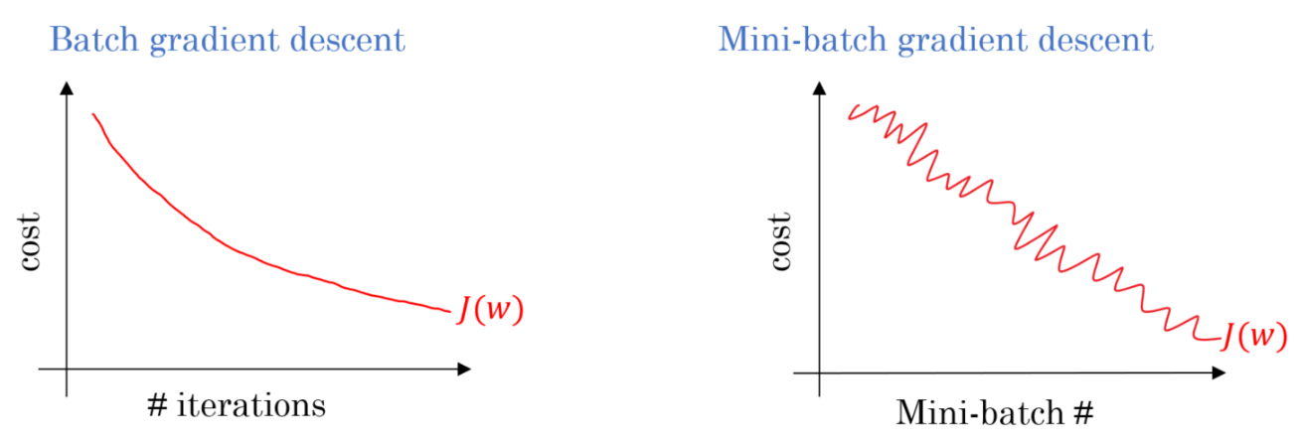
Stochastic Gradient Descent
The data is “noisier”
May need to reduce the learning rate
The cost value for each mini-batch may be different
Look at the average across all mini-batches
Or re-compute against the full training set once in a while

Slide 37
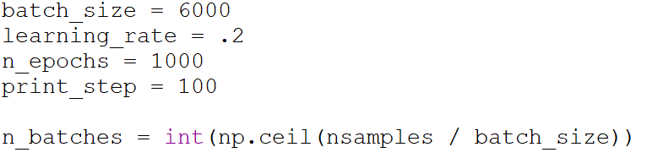
Mini-Batch Softmax Regression in Tensorflow
Select a batch size and compute the number of batches
This example uses 10 batches of 6000 samples each
The total number of iterations is n_epochs * n_batches = 10,000
See Mnist_SoftmaxRegression_tf_3.py

Slide 38

Mini-Batch Softmax Regression in Tensorflow
We will need to use Tensorflow placeholders
Allows us to feed different data to the computation later
Replace the input vectors with placeholders
None means that the length is left unspecified
See Mnist_SoftmaxRegression_tf_3.py

Slide 39
Mini-Batch Softmax Regression in Tensorflow
In the update loop, construct the data vectors for the batch
Put them into a “feed dictionary”
This is used to replace the placeholders for X and Y
Pass the dictionary to the session run
See Mnist_SoftmaxRegression_tf_3.py

Slide 40
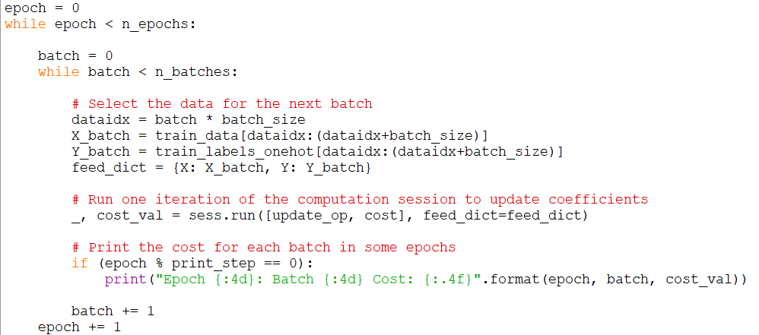
Mini-Batch Softmax Regression in Tensorflow
Update loop:
See Mnist_SoftmaxRegression_tf_3.py

Slide 41

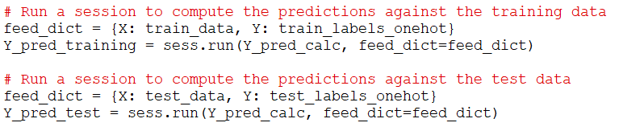
Getting the Prediction Values
We can take advantage of the feed mechanism to get prediction values for the test dataset
In the computation graph, just add the missing Softmax function and compute the maximum prediction value
In the testing, feed the entire test data (or entire train data) to get the full vector of predictions
See Mnist_SoftmaxRegression_tf_3.py

Slide 42
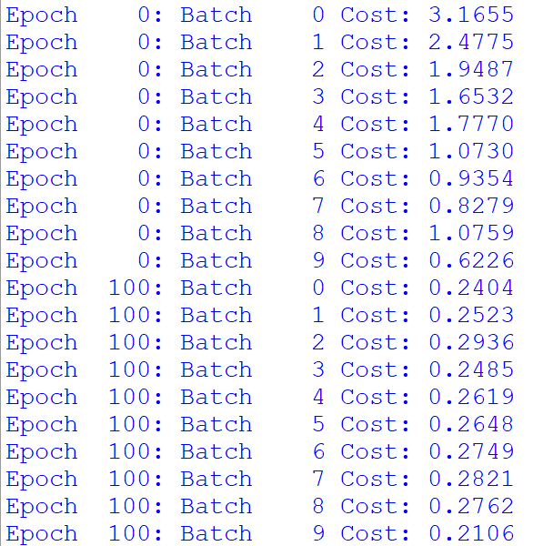
Mini-Batch Softmax Regression in Tensorflow
In the first few epochs we see a general reduction in cost with each batch processed
There is some variability from batch to batch
See Mnist_SoftmaxRegression_tf_3.py

Slide 43
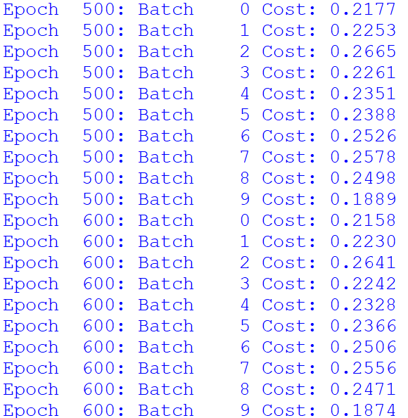
Mini-Batch Softmax Regression in Tensorflow
After several 100s of epochs we see a trend:
The cost per batch varies
The cost of each batch is gradually decreasing
It is hard to tell what the overall cost is
We will need to compute the average cost across batches
See Mnist_SoftmaxRegression_tf_3.py

Slide 44
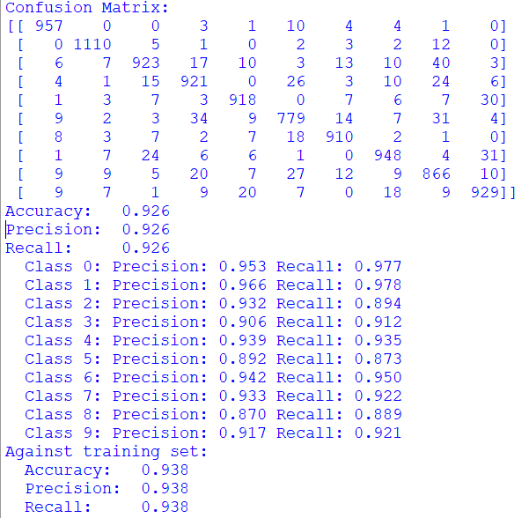
Mini-Batch Softmax Regression in Tensorflow
The results are good
Consistent with full-batch results
See Mnist_SoftmaxRegression_tf_3.py

Slide 45
Practice 3
Consider the mini-batch gradient descent solution of softmax regression of MNIST images
From Mnist_SoftmaxRegression_tf_3.py
In the update loop when the epoch matches the print step, compute and print the average cost for all the mini-batches in this epoch
Also compute the minimum and maximum cost for any mini-batch in this epoch
Hints:
Store the cost values in a list of length n_batches
Move the if (epoch % print_step == 0) outside the batch loop

Slide 46
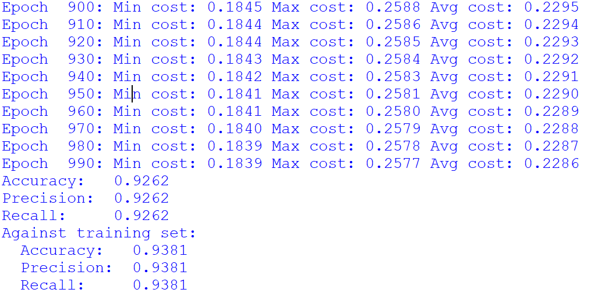
Practice 3

Slide 47
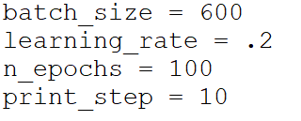
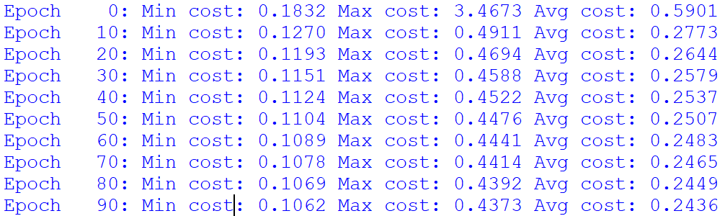

Mini-Batch Softmax Regression in Tensorflow
Let’s try with smaller batches
Lost some accuracy:

Slide 48
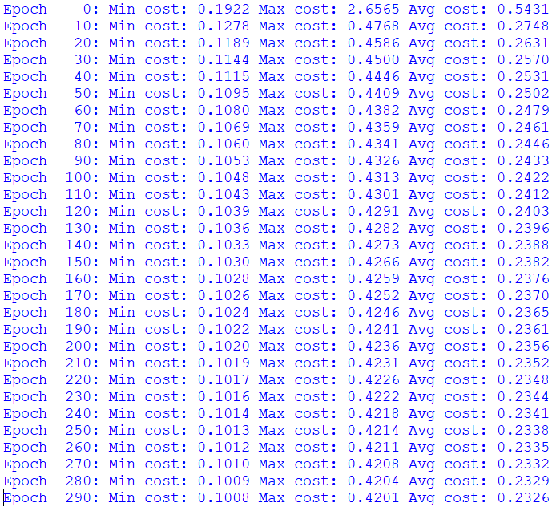

Mini-Batch Softmax Regression in Tensorflow
We can add more iterations
With n_epochs = 300, learning rate = 0.2:
The results did not improve
We need to reduce the learning rate
To average out the noisy mini-batches

Slide 49
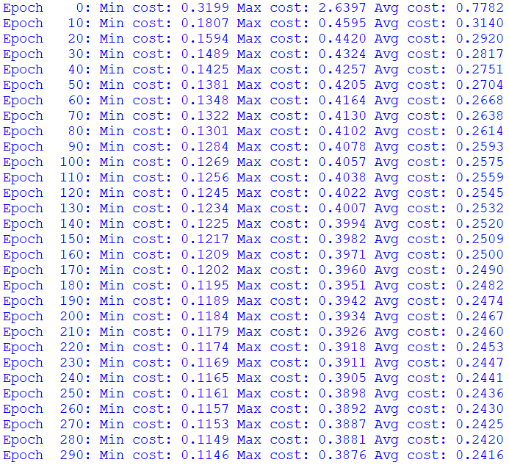

Mini-Batch Softmax Regression in Tensorflow
With:
n_epochs = 300
learning rate = 0.02:
The results are better
The average cost per mini-batch is a little bit higher
But the variance is smaller
The average cost per mini-batch is not necessarily a good indicator of test accuracy
If you want to be sure, compute and print the test accuracy at every print step
See Mnist_SoftmaxRegression_tf_4.py

Slide 50
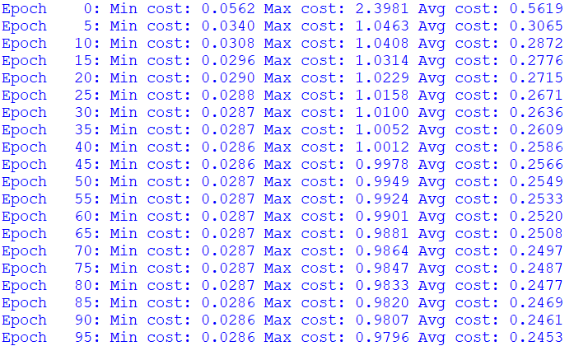

Mini-Batch Softmax Regression in Tensorflow
Let’s try with even smaller batches:
With:
batch_size=60
n_epochs = 100
learning rate = 0.005
The results are good
And it ran much faster
See Mnist_SoftmaxRegression_tf_4.py

Slide 51
Selecting the Batch Size
How to choose the batch size?
There is no hard rule
Generally, the smaller, the faster
Even if you need to add more iterations to compensate
You may need to use smaller learning rate and more iterations if it is very small
Because smaller mini-batches are noisier
Powers of 2 can be more efficient
A common value is 32

Slide 52
Selecting the Learning Rate
There is no hard rule for setting the learning rate
If it is too large, your adaptation will diverge
You will get Inf coefficients
Larger values (that do not diverge) help converge faster
But may not converge deeper
Smaller values may converge deeper
But need more iterations to converge
Recommendation:
Try a few common values (0.1, 0.01, 0.001)
Pick the largest that converges
Let it run with plenty of epochs, until it settles
Try a bit smaller to see if it converges deeper
Adaptive schemes can be more effective (learning-rate schedules)
Start large, and reduce gradually

Slide 53

Break
Back at

Slide 54
Neural Networks

Slide 55
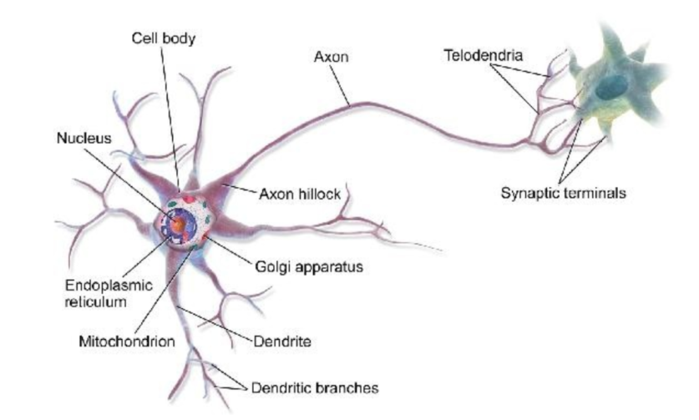
Inspiration of Neural Networks
Brain neurons are interconnected to others by axons
They activate by sending a spike of electrical charges (synapses)
Neurons fire/activate in response to the level of activation of their neighbors

Slide 56
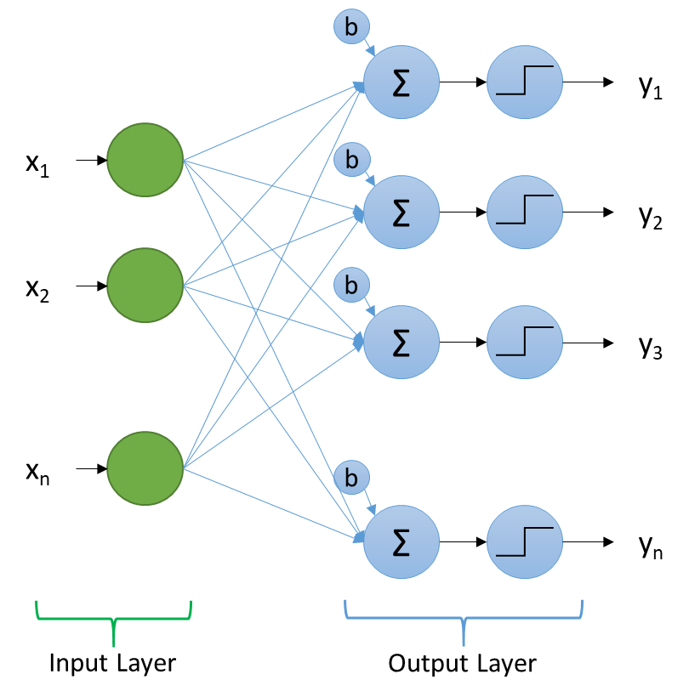
The Perceptron
An early prototype of artificial neural network
Also known as Linear Threshold Unit (LTU)
A linear combination of inputs, followed by a step function
The output of each LTU is 1 or 0
The step function is considered an activation function
Mimics brain neural activations
Equivalent to Linear Regression with a threshold

Slide 57
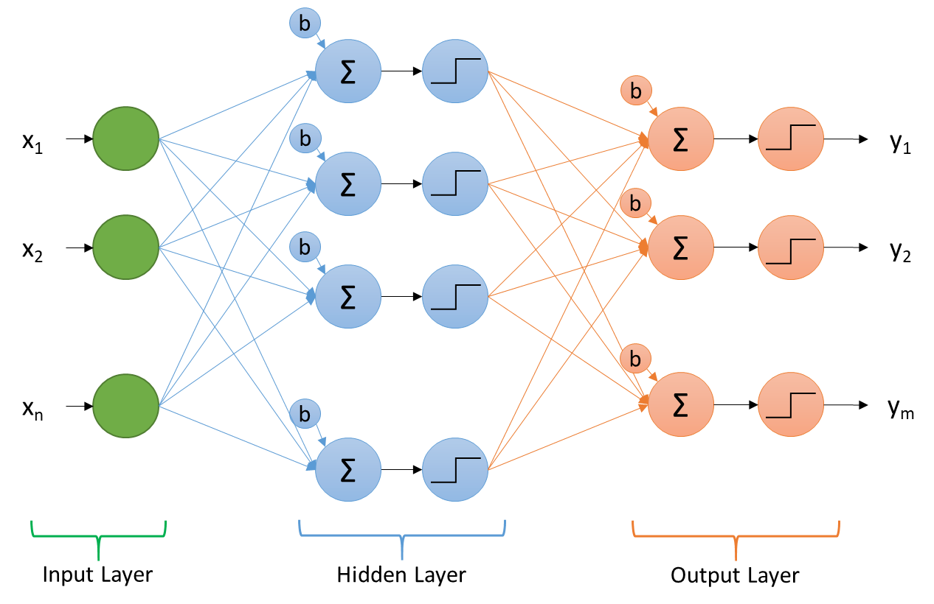
Multi-Layer Perceptron (MLP)
Adds one or more hidden layers
Each is a linear combination of the previous, followed by a step activation function
No successful way to train it
Cannot use gradient descent (gradients are zero)

Slide 58
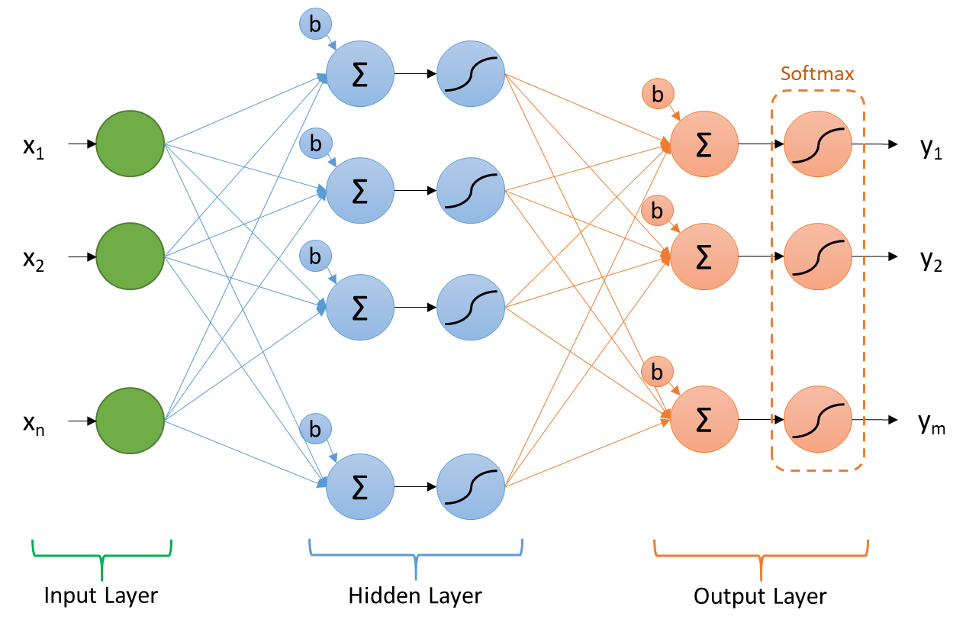
Multi-Layer Sigmoid Regression
Uses a sigmoid as the activation function of the hidden layer neurons
Uses softmax for the output layer
Can be trained by gradient descent
Computed efficiently using reverse-mode auto-diff
A.k.a. back-propagation
This is the basis of most modern neural networks

Slide 59
Anatomy of a Neural Network
b
Σ
Softmax
b
x₁
b
Σ
y₁
Σ
b
x₂
b
Σ
y₂
Σ
b
x_{n}
Σ
y_{m}
b
Σ
Input Layer
Hidden Layer
Output Layer

Slide 60
The Need for Activation Functions
Activation functions in hidden layers introduce non-linearities
Without them, the entire structure would be a linear system
Limited flexibility to fit to data
Allows the network to become a universal function approximator
Any non-linear function will work
But we want it to be differentiable so we can use it in gradient descent
Several activation functions are used in practice

Slide 61
Activation Functions for Output Layer
Type of Problem | Recommended Activation Function | Characteristics
Regression | Linear | Keep the linear combination of values
Binary classification | Logistic | A sigmoid function with outputs between 0 and 1
Multinomial classification | Softmax | Each output is between 0 and 1 All values add-up to 1.0

Slide 62
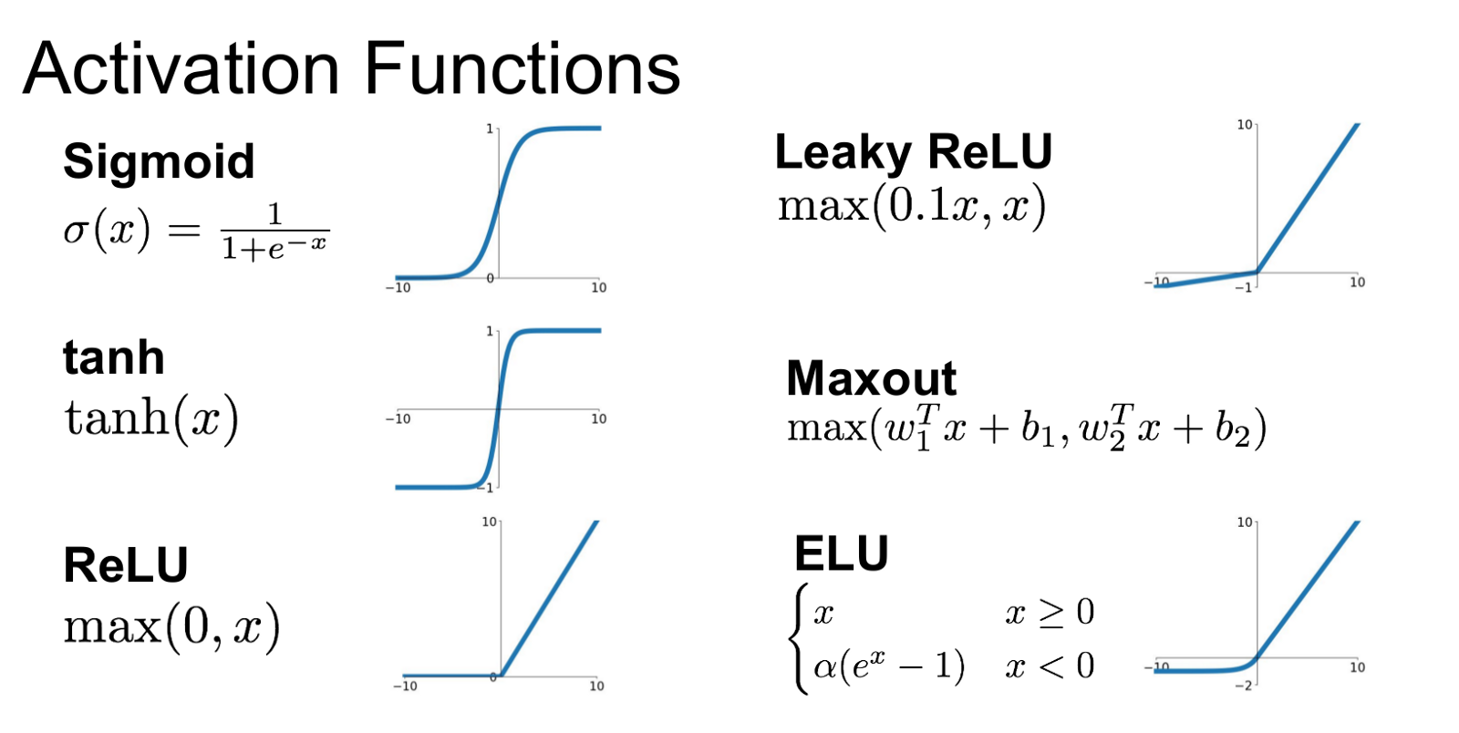
Activation Functions for Hidden Layers
Activation Function | Characteristics
Hyperbolic Tangent (TanH) | A sigmoid function with outputs between -1 and 1 Expensive to compute Subject to vanishing gradients
Rectified Linear Unit (ReLU) | Fast and effective Avoids vanishing gradients Can lead to neuron death
Leaky ReLU | A modified version that prevents neuron death
Exponential Linear Unit (ELU) | Best performing Avoids discontinuity around zero Expensive to compute

Slide 63
Shallow Neural Networks
Networks with 1 hidden layer
Generally referred to as a 2-layer network
One hidden layer
One output layer
The input layer is not counted
The number of nodes in the output layer is determined by the number of outputs
The number of nodes in the hidden layer can be chosen at will
More nodes will allow the model to capture more complexity

Slide 64


2-Layer Neural Net on TensorFlow
Let’s create a 2-layer network for solving the MNIST classification problem
We will use TanH activation on the hidden layer
And softmax for the output layer
The number of nodes in the hidden layer will be a tunable design parameter
Along with the learning rate, mini-batch size, and number of epochs
See Mnist_NN_1.py

Slide 65

2-Layer Neural Net on TensorFlow
We start with the previous implementation of softmax regression with mini-batch gradient descent
We modify the computations to include the two layers
The output of the first layer becomes the input of the second layer
See Mnist_NN_1.py

Slide 66


2-Layer Neural Net on TensorFlow
The cost function is the same as before (softmax cross entropy)
But applied to the output of the second layer
The prediction values are also computed from the output of the second layer
Still need to add the softmax to the linear outputs, and then find the maximum
See Mnist_NN_1.py

Slide 67

2-Layer Neural Net on TensorFlow
Try with 100 nodes in layer 1, tanh activation:
Very promising results!
See Mnist_NN_1.py

Slide 68
Practice 4
Consider the 2-layer neural network for MNIST classification
From Mnist_NN_1.py
Modify the number of nodes in the hidden layer
Try values like 10, 50, 100, 500, 1000, etc.
For each case, let it train and measure the accuracy against the test set, and also against the training set
Comment on your results

Slide 69
Effect of the Number of Hidden Neurons
On MNIST classification
2-Layer neural network
TanH in hidden layer
Softmax in output layer
Learning rate = 0.03
Batch size = 60
Num epochs = 50
After a few 100s of nodes, the neural net is capable of completely memorizing the training data
Overfitting
Number of Nodes in Layer 1 | Test Accuracy | Train Accuracy
10 | 0.912 | 0.932
50 | 0.969 | 0.996
100 | 0.976 | 1.000
500 | 0.982 | 1.000
1000 | 0.983 | 1.000

Slide 70
Optional HW Problem 4b
Repeat the Practice 4 but using different activation functions for the hidden layer
You can try ReLU & ELU
Are your results different?
Is it any faster/slower?

Slide 71

2-Layer NN for Vehicle Price Regression
It is very similar to the MNIST
There is only one output, so this is reflected in the definition of Y
See VehiclePrice_NN_1.py

Slide 72

2-Layer NN for Vehicle Price Regression
Chose to use ELU activation for the hidden layer
Others can work as well
We use no activation in the output layer
Y_L2_linear will go directly into the cost function optimizer
See VehiclePrice_NN_1.py

Slide 73

2-Layer NN for Vehicle Price Regression
The cost function is the mean square error of the layer 2 outputs
The test results are the square root of the costs for the test vectors
See VehiclePrice_NN_1.py

Slide 74

2-Layer NN for Vehicle Price Regression
The learning rate needs to be quite a bit smaller for this type of cost function
See VehiclePrice_NN_1.py

Slide 75

2-Layer NN for Vehicle Price Regression
2-Layer neural network
ELU in hidden layer
Linear in output layer
Learning rate = 1e-5
Batch size = 60
n_nodes_l1 =100
n_epochs = 100
Very promising results!
See VehiclePrice_NN_1.py

Slide 76
Effect of the Number of Hidden Neurons on Vehicle Price Regression
2-Layer neural network
ELU in hidden layer
Linear in output layer
Learning rate = 1e-5
Batch size = 60
Num epochs = 100
Overfitting
The RMSE for training keeps improving
The RMSE for test does not improve beyond 100 neurons or so
Number of Nodes in Layer 1 | Test RMSE | Train RMSE
10 | 6316 | 6372
50 | 3360 | 3202
100 | 3304 | 3086
500 | 3303 | 2990
1000 | 3307 | 2976

Slide 77

Practice 5
Create a 2-layer neural network for the classification of credit defaults
Suggestions:
For the cost function, use sigmoid_cross_entropy_with_logits
Compute the prediction probabilities with tf.nn.sigmoid(Y_L2_linear)
Suggested training parameters:
batch_size = 60
learning_rate = .02
n_epochs = 500
n_nodes_l1 = 10
Activation function: ReLU
Compute the AUC score against the test data set and against the training data set

Slide 78
2-Layer NN for Credit Default
2-Layer neural network
ReLU in hidden layer
Logistic in output layer
Learning rate = 0.02
Batch size = 60
Num epochs = 500
Overfitting after 15 nodes
Training results get better
Test results get worse
Number of Nodes in Layer 1 | Test AUC Score | Train AUC Score
5 | 0.706 | 0.714
8 | 0.709 | 0.720
10 | 0.713 | 0.723
15 | 0.715 | 0.730
20 | 0.713 | 0.728
50 | 0.706 | 0.745
100 | 0.706 | 0.760

Slide 79
How to Prevent Overfitting in Neural Networks?
This is an active area of research
Some popular techniques include:
Early stopping
L1/L2 regularization
Dropout
Data augmentation
Others

Slide 80
Early Stopping
When the network is larger than necessary, it will overfit the training data
The performance against the test set degrades
If we don’t let the training fully converge, it doesn’t overfit as much
The performance against the test set can be better than for a fully-converged model
We can check the test score periodically in the middle of the training
Every certain number of epochs
Stop the training when the test score stops improving or degrades

Slide 81

Observing the Test Score over Time
To understand if we need to stop early, we need to observe the test scores over time during the training process
In the update loop, every certain number of epochs, compute the score against the full test set
See CreditDefault_NN_2.py

Slide 82

Early Stopping
With n_nodes_l1 = 100:
It reached a maximum at epoch 340
Then it decreased
It would have been a good idea to stop at iteration 340
We could also save the coefficients of the best model and restore them later
See CreditDefault_NN_2.py

Slide 83
Early Stopping
An algorithm for early stopping would be:
Periodically check the test score
If the test score is better than the previous best:
Save the model coefficients
If the test score is x% worse than the previous best
Stop training
Restore the best model coefficients and use them

Slide 84
L1/L2 Regularization
Penalizes large coefficients
Both help avoid overfitting in neural networks
L1-Norm (Lasso regularization)
Penalizes the sum of the absolute value of the coefficients
Tends to produce many zero coefficients
Could be useful to feature selection and pruning of the network
L2-Norm (Ridge regularization)
Penalizes the sum of the square of the coefficients
Tends to produce small but non-zero coefficients
Generally better performing than L1
There is a tuning parameter for the regularization weight

Slide 85

L1-Regularization in TensorFlow
You need to implement a new component of the cost function, that computes the sum of the absolute value of the coefficients
This new cost is multiplied by the regularization scale, and added to the original cost function
See CreditDefault_NN_3.py

Slide 86

L1-Regularization in TensorFlow
With:
n_nodes_l1 = 100
regularization_scale = 1e-4
n_epochs = 1000
The test score kept increasing for longer and then stabilized
See CreditDefault_NN_3.py

Slide 87
L2-Regularization in TensorFlow
The L2-norm is the square of the coefficients added together
The regularization scale that works well for L2 may be different that what works well for L1
See CreditDefault_NN_4.py

Slide 88

L2-Regularization in TensorFlow
With:
n_nodes_l1 = 100
regularization_scale = 5e-4
n_epochs = 1000
In this case it was not as effective as L1 regularization
See CreditDefault_NN_4.py

Slide 89

Regularization for Vehicle price Regression
2-Layer neural network
Learning rate = 1e-6
n_nodes_l1 = 300
No regularization
It peaks at epoch 140
Then it gets a bit worse
See VehiclePrice_NN_2.py

Slide 90

Regularization for Vehicle price Regression
2-Layer neural network
Learning rate = 1e-6
n_nodes_l1 = 300
L2 regularization
regularization_scale = 1e-5
Better results
Test score keeps improving for longer
See VehiclePrice_NN_2.py

Slide 91

Regularization for MNIST
2-Layer neural network
Learning rate = 0.02
n_nodes_l1 = 500
No regularization
Not improving beyond epoch 160
See MNIST_NN_3.py

Slide 92

Early Stopping for MNIST
2-Layer neural network
Learning rate = 0.02
n_nodes_l1 = 500
L2 regularization
regularization_scale = 1e-4
Better
Seems to have peaked at epoch 400
Can try with a bit stronger regularization
See MNIST_NN_3.py

Slide 93
What else can we do to Improve Performance?
Visualize training evolution
Cost over time/epoch
Training and test scores over time
Use learning-rate schedules
Use varying learning rate
Start large, then gradually reduce
Or adaptive depending on the variation of the gradients
Save and restore the best model
Whenever you get a good result, save the model to disk
Use it as the starting point for further attempts
Instead of starting from random coefficients
Other regularization schemes
L1+L2
Max-norm
Dropout nodes
Data augmentation
All of these are easier done with a high-level API like Keras

Slide 94

Dropout
A technique that removes a portion of the neurons at every training step
The dropped neurons produce a zero output for that step
The percentage of neurons that get dropped is controlled with a dropout_rate parameter
Allows fine control of overfitting

Slide 95

Data Augmentation
If you don’t have more training data, you can generate some based on your existing data
Apply simple transformations that are reasonable for the type of data being used
For example: slightly shift or rotate images
Of course, the best is always to get more real data if possible

Slide 96
Thank you

